Slide 1
Options pricing calculator
with Black Scholes model and Binomial model
Yu-Chen (Amber) Lu
MS Financial Engineering
Notes:
My name is Amber. I am going to introduce options pricing calculator with black schloes model and binomial model.

Slide 2
Agenda
Problem Statement
Objective
Input variables
Output variables
Model demonstration
Future work
Python Resources
Notes:
Here is my agenda. First, I will talk about my Motivation And objective. And then, go through my option pricing model. The last two slides will present my future work and resources

Slide 3
Problem Statement
Option price?
Notes:
Options are contracts that give investors the right to buy or sell an asset at a strike price at the maturity day. With options, it is possible to profit whether the stock price goes up, down or sideways in the future. However, an investor can loss money from trading options. In order to kwon what an option price should be, this calculate provides some data of options.

Slide 4
Objective
This calculator is modeled by Black Schloes and two binomial tree methods.
Black-Scholes model
Binomial model
Cox_Ross_Rubinstein binomial model
Jarrow_Rudd binomial model

Slide 5
Input Variables
Underlying price (per share): S;
Strike price of the option (per share): K;
Time to maturity (years): T;
Continuously compounding risk-free interest rate: r;
Volatility: sigma;
 | Symbol | Input
Underlying price | S | 100.00
Strike price | K | 110.00
Time to maturity | T | 2.22
Risk-free interest rate | r | 5.00
Volatility | sigma | 30.00
Notes:
in option pricing, we need five input variables, underlying price,…,.
This table shows an example.

Slide 6
Black-Scholes model
Notes:
The First model is black schloes model which is the first widely used model for option pricing

Slide 7
Black-Scholes model
Certain assumptions
It works on European options that can only be exercised at expiration.
No dividends.
Stock markets are efficient.
The risk-free rate and volatility of the underlying are known and constant.
The returns on the underlying are normally distributed.
Notes:
There are certain assumptions in black schloes model

Slide 8
Output Variables – Black-Scholes model
From BS model, we can know
Also, implied volatility
 | Call | Put
Price | 17.511643 | 15.945466
delta | 0.717434 | -0.282566
gamma | 0.007561 | 0.007561
vega | 0.503989 | 0.503989
rho | 1.204986 | -0.982133
theta | -0.061140 | -0.011923
PUT
CALL
PRICE
$20
IV
38.4%
Notes:
Form this calculator, we can know the call option price, put option price, and greeks letter of options. Moreover, the implied volatility can be calculated.

Slide 9
Binomial model
Notes:
Next, in binomial model, All trees are built from four parameters (u, d, p and q).
u present the percentage of the asset price rising, p is the probability of the asset price rising
On the other hand, d is the percentage of the asset price falling, q is the probability of the asset price falling

Slide 10
Binomial model
Certain assumptions
The two possible prices are the up-price and down-price
No dividends are paid out during the option’s life.
The risk-free rate is constant throughout the life of the option
Investors are risk neutral
** All trees are built from four parameters (u, d, p and q).
Notes:
Binomial model has certain assumptions

Slide 11
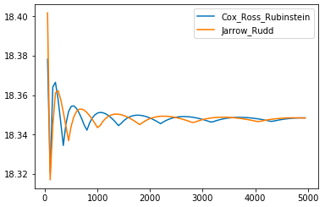
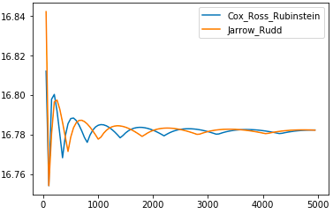
Output Variables – Binomial model
From two binomial models with 1000 steps, we can know
Also, call option price with different steps
Put option price with different steps
 | Option | Price
Cox-Ross-Rubinstein | Call | 18.35
Cox-Ross-Rubinstein | Put | 16.78
Jarrow-Rudd | Call | 18.34
Jarrow-Rudd | Put | 16.78
Notes:
Option price is calculated by two different binomial tree methods which are based on different assumptions of the four parameters. The red table shows prices with 1000 steps. And on the right side two graphs are comparing options price in different steps between these two methods

Slide 12
Model demonstration

Slide 13
Future work
Strength this calculator
Develop option pricing package
Add more binomial tree methods
Add dividend into model
Add model for American option
Practical applied
Compare prices between real price and estimated price
Analysis the pricing model that matches the real price mostly
Notes:
Two part to work on my future work

Slide 14
Python Resources
Pandas: Pandas is a Python package for data analysis. In particular, it offers data structures and operations for manipulating numerical tables and time series.
Numpy: Numpy is a fundamental package to support for multi-dimensional arrays and matrices. It is not only used for scientific computing, but also for multi-dimensional container of generic data.
Math: Math provides access to the mathematical functions, such as pi, log, exp, sqrt, and other mathematical functions.
Statistics: Statistics provides access to the statistics functions, such as norm_pdf, norm_cdf, mean, stdev, and other statistics functions.

Slide 15
Yu-Chen (Amber) Lu
ylu46@stevens.edu

